Slide 1

SEND Information Report
2025-2026

Slide 2

SEND POLICY
Local Offer
The Local Offer is a description of locally available provision across education, health and social care in Somerset. It sets out what provision can be expected from schools, the Local Authority and other specialist services. It is published online here:
The SEND Policy is a description of the vision and values underpinning our approach to SEND. It is published on the school’s website here:
SEND INFORMATION REPORT
The SEND Information Report clearly communicates how the school implements our SEND Policy and provides information on the types of support available for children at Crowcombe & Stogumber Primary Schools. It is designed to provide information on who can help and how this help can be accessed.

Slide 3
Our School Vision for Inclusion
What does Inclusion mean to us?
At our schools, inclusion means that every child is valued, supported, and given the opportunity to succeed. We are committed to creating an environment where all children can learn, grow, and take part fully in school life.
Our vision, “Together let us love, encourage, achieve and flourish,” is at the heart of our inclusive ethos.
Love – We show care, respect, and compassion for one another, celebrating each child’s individuality and worth.
Encourage – We nurture confidence, resilience, and a belief that every child can make progress and reach their goals.
Achieve – We remove barriers to learning and provide high-quality teaching and tailored support so that every pupil can achieve their best.
Flourish – We create opportunities for all children to thrive academically, socially, and emotionally within a safe and nurturing community.
Inclusion at our school means working together – with pupils, families, staff, and external professionals – to ensure that every child feels they belong and can flourish as part of our learning community

Slide 4

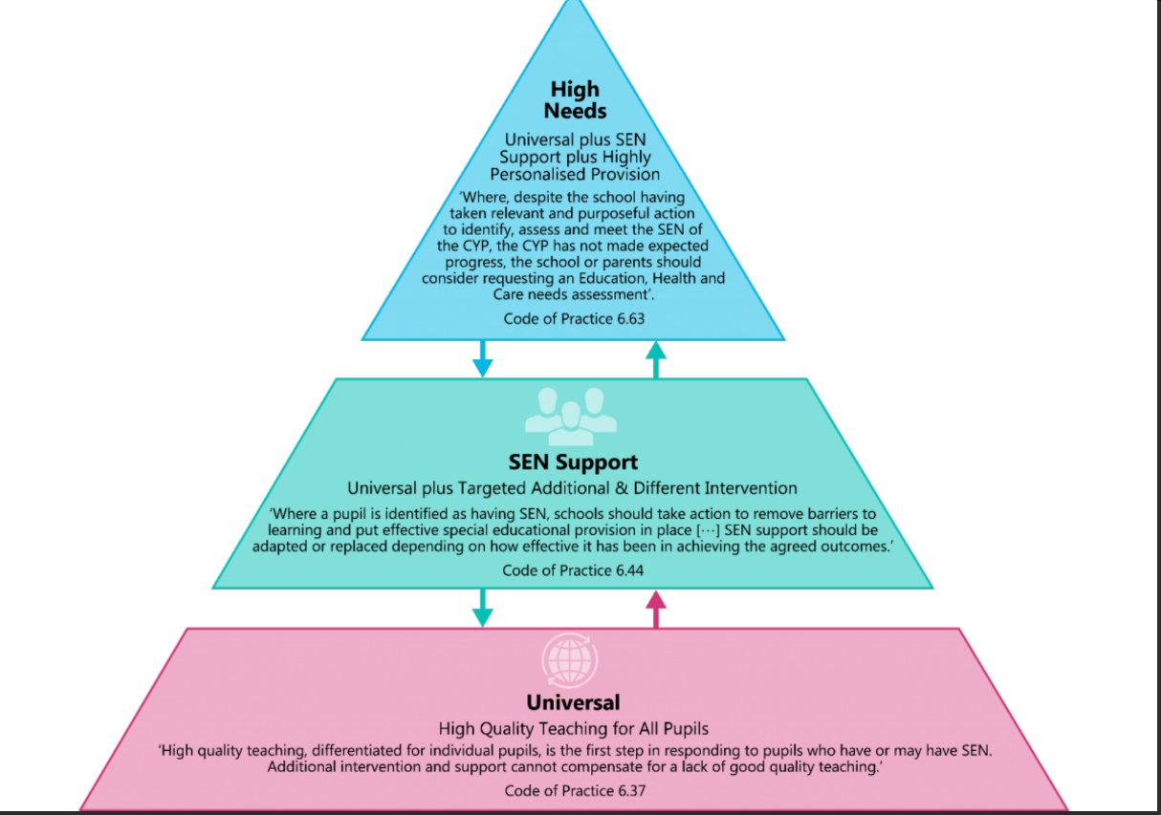
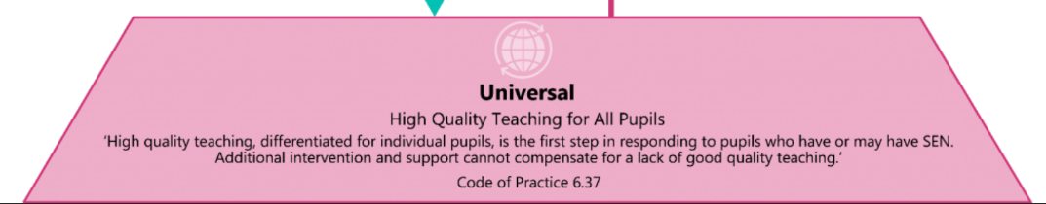
Whole School Approach
Universal Support
Universal Support is the foundation of our provision, ensuring every learner has access to high-quality teaching and an inclusive environment. Through consistent, evidence-based approaches, we meet the needs of all pupils while identifying those who may benefit from additional targeted support. Our focus is on creating a classroom where every child can thrive, feel confident, and make progress. High quality teaching focuses on inclusive practice and breaks down barriers to learning. For the majority of children this can be achieved by identifying specific barriers, followed by adapted teaching using strategies as identified in the Somerset Graduated Response Tool. The Somerset Graduated Response Tool breaks down SEN into four broad areas of need. This targets specific support for teachers to plan and for any interventions to take place. You can learn more about the Somerset Graduated Response here
Examples of Whole-Class Universal Provision
Clear, consistent lesson structures and routines
Adapted tasks and scaffolding to support varying needs
Visual aids, word banks, and accessible resources for all learners
Opportunities for partner talk and collaborative learning
Regular check-ins and formative assessment to guide teaching
Examples of Small-Group Universal Provision
Guided reading or maths groups focusing on specific skills
Targeted vocabulary or phonics sessions
Short, focused intervention groups to reinforce key concepts
Social-skills or emotional-regulation groups
Pre-teaching or over-learning sessions to build confidence

Slide 5
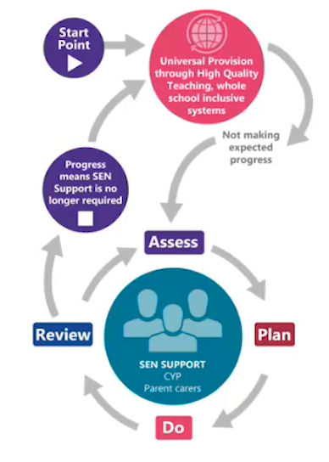
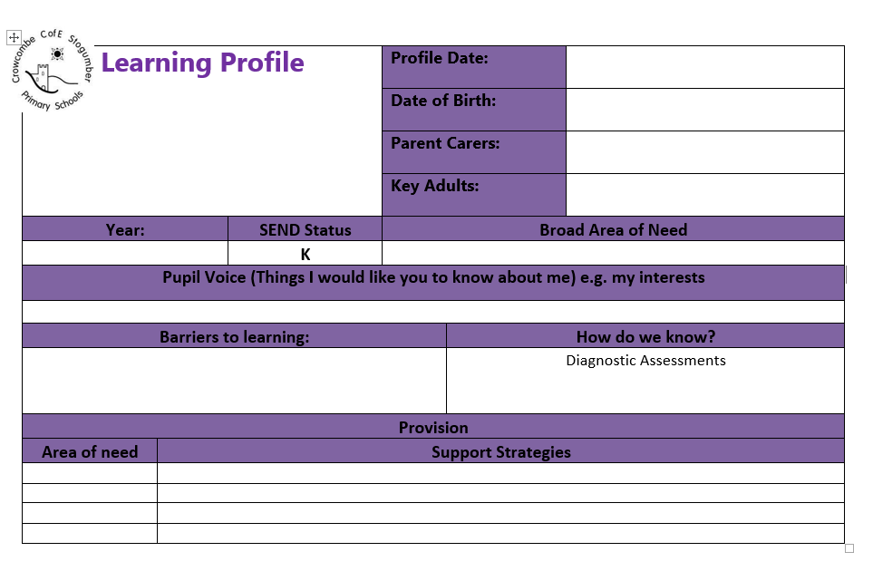
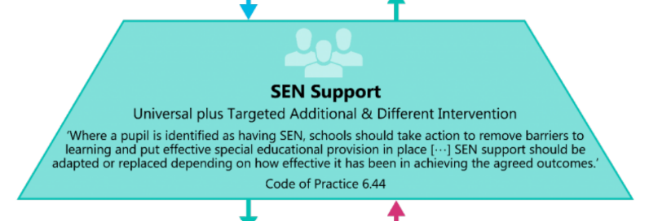
Whole School Approach
SEND Support
A child may be identified for SEND Support when, despite access to high-quality universal teaching and targeted strategies, they are still not making the expected progress. This may be academically, socially, emotionally, or in their communication or physical development. When concerns arise, the school follows the Assess–Plan–Do–Review (APDR) cycle to understand the child’s needs, implement personalised support, and monitor the impact over time. If additional, sustained adjustments are required to help the child achieve their potential, they will be placed on SEND Support so that a more tailored and structured approach can be provided in partnership with parents, carers, and relevant professionals.
SEND Support ensures that pupils with special educational needs and disabilities receive the personalised, high-quality provision they need to succeed. Working in partnership with families, teachers, and external professionals, we remove barriers to learning through tailored strategies, careful assessment, and inclusive practice. Our aim is to enable every learner to feel valued, supported, and able to make meaningful progress.

Slide 6
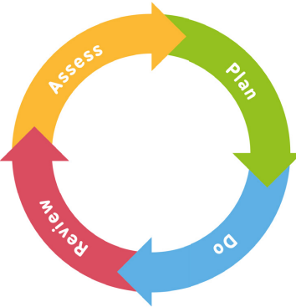
Whole School Approach
Assess, Plan, Do, Review (APDR)
Assess
To enable us to have a clear idea of a child’s strengths and difficulties, class teachers will use ongoing class observations and assessments, as well as views from parent carers and pupils to identify any potential barriers to learning. Additional specific assessments may also be requested from the SENDCo.
Review
Termly reviews of the interventions will be carried out by the class teachers and the SENDCo to evaluate the progress towards the desired outcomes. Further outcomes and support will be agreed and shared with the parent carers if required
Plan
Once a need has been identified, the class teacher and the SENDCo will work together to agree any additional provision or interventions with desired outcomes. Parent & pupil voice will be gathered as part of this.
Do
The additional support and intervention is carried out and the class teacher will liaise with any adult providing additional support and parents and carers regarding this.

Slide 7
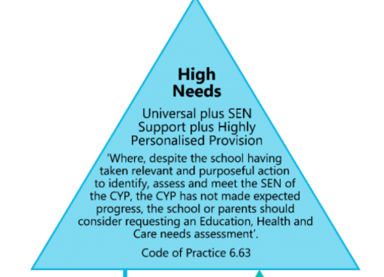

High Needs
Education, Health and Care Plans (EHCPs)
An Education, Health and Care Plan (EHCP) is considered when a child or young person requires support that goes beyond what can be provided through SEN Support. If, after several cycles of Assess–Plan–Do–Review (APDR) and involvement from relevant professionals, a child is still not making expected progress or has significant, long-term needs, the school or parent may request an EHCP Needs Assessment from the local authority.
An EHCP sets out a child’s specific strengths, needs, outcomes, and the provision required to meet those needs. This may include highly personalised teaching approaches, specialist interventions, therapies, or additional adult support. Provision within an EHCP is bespoke and individualised, ensuring the child receives the right level of support to access learning, thrive, and achieve meaningful long-term outcomes.

Slide 8

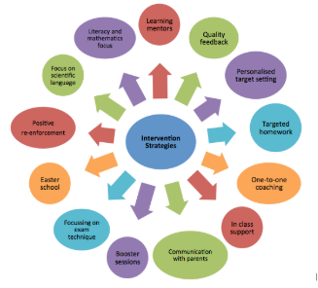


Funding for Inclusive Provision
The school budget is received from Somerset County Council. The headteacher then makes decisions around the allocation for SEND in collaboration with the governors, the finance officer and the SENDCo. This is based on the need within the school and is reviewed regularly.
At Crowcombe and Stogumber Primary Schools we use our SEND funding to ensure high-quality, inclusive teaching for all pupils. This includes employing teaching assistants, providing specialist resources, running targeted interventions, and offering training for staff to enhance universal provision. In addition, funding supports tailored, specific interventions and enables access to our specialist staff, including our ELSA and Forest School-qualified staff, to meet individual needs and help every child thrive.
For some children who’s needs are severe, complex or lifelong, additional high needs funding may be provided by the local authority through an EHCP (Education, Health and care plan) to ensure they get the right support to learn, progress, and thrive.

Slide 9


Accessibility
We are committed to ensuring that our schools are accessible, inclusive, and compliant with the requirements of the Equality Act 2010 and the SEND Code of Practice. We aim to remove barriers to learning and participation so that every child can access a broad and balanced curriculum.
Both of our school sites have accessible toilet facilities, and one site also includes a rise-and-fall changing table to support pupils with personal care needs. One site is predominantly wheelchair accessible, while the other—due to the age and layout of the building—has recently undergone an accessibility audit by a specialist team. We use the findings of this audit to make reasonable adjustments and plan improvements wherever possible.
We work closely with external support services to ensure we meet the needs of pupils with specific difficulties, including hearing impairments, physical disabilities, and other access requirements.
In addition, we provide emotional and social development support through our ELSA and Learning Outside the Classroom (LOTC) specialist. Off-site learning experiences form a regular part of our curriculum, and all visits are carefully risk assessed and planned to be fully inclusive, ensuring every pupil can participate regardless of their needs.
We continually review our accessibility arrangements and are committed to ongoing improvement so that all children can thrive within our school community.

Slide 10




Support and Training for Staff
Our staff are supported to meet the needs of all pupils through specialist training and collaborative working. Both our SENDCO and Headteacher are qualified SENDCOs, with the SENDCO accessing termly training and local network meetings to stay up to date with best practice. Staff receive CPD in high-quality inclusive teaching through the Great Teacher Toolkit, alongside bespoke training on specific needs and strategies, including Autism, ADHD, dysregulation, and cognition and learning difficulties.
In addition, class teachers are supported through termly Inclusion Meetings, where senior leaders and teachers collaborate to assess, plan, and review provision, ensuring every child receives the support they need to thrive. Termly monitoring is also carried out by the SENDCO and SEND governor, helping to review and strengthen the effectiveness of provision across the school.

Slide 11


School Partnership & Transition
Starting School
When starting school in Reception we will hold a school entry plan meeting with you and all professionals involved to share information and to plan the support they will require to make the transition to school successful.
Moving on
When your child is moving on to secondary school we will carry out a transition meeting with the SENDCo from your child’s new school to share information and carefully plan any enhanced transition that they may require, including extra visits.
A new class
When your child changes classes within the school we will hold a transition meeting with the next teacher and plan any additional support that will be required.
Joining us during the year
If your child moves to Crowcombe and Stogumber Primary Schools we will contact the SENDCo at their previous to school to request any information and then have a transition meeting with you to plan any support that may be required.
Leaving us during the year
If your child moves to a new primary school during their time with us, we will contact the SENDCo at their new school to share information and ensure records are passed on as quickly as possible.

Slide 12

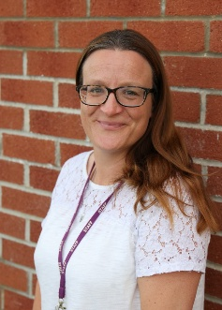
Who to talk to in school
Your child’s class teacher is responsible for your child’s learning and progress and are the first person you should talk to about your concerns.
Mrs Janis Dean is our SEND Governor and is responsible for supporting and developing the awareness of SEND within the governing body.
Mrs Carter is our school SENDCo and she holds the NASENCO qualification. Her working days are Tuesday and Friday. She can be contacted via the school office via phone or email.
Mrs Kate Lewis is our Headteacher and is responsible for the day to day management of all aspects of the school.
Got a Concern About SEND?
If you have concerns about your child’s SEND support:
Talk to your child’s class teacher first.
Contact the SENDCO for extra guidance.
Headteacher or Key Stage Leads are also available via the school office.
If needed, you can refer to our Complaints Policy on the website.

Slide 13



External Support Services
Our schools are supported by services from Somerset’s Support Services for Education who will provide advice through the Inclusion Advice Line. In addition the schools are able to use some of their budget to fund support from the Educational Psychology Service.
Our school works in partnership with Taunton Deane Partnership College who can provide support to individuals with social, emotional and mental health needs as well as staff training.
In addition we are supported by professionals from NHS Somerset Partnership Trust, who provide specialist support for individual pupils. These services include Occupational Therapists (OT), Speech and Language Therapists (SALT), Physiotherapists (PT) and the Child and Adolescent Mental Health Service (CAHMS)

Slide 14





Support for Families
We value parents and carers as partners in their child’s learning and development. We involve families in discussions about additional needs, share progress and strategies, and work together to plan and review support. By listening to parents’ insights and collaborating closely, we ensure that provision is personalised, effective, and meets the needs of every child. Please do reach out to your child’s class teacher if you have any questions or concerns.
In addition to class teachers, Tean, our Parent and Family Support Advisor (PFSA), is available to provide guidance and support to families. The PFSA can help with a wide range of concerns, including accessing services, understanding additional needs, and offering practical advice to support your child’s learning and wellbeing.
External organisations available to support parents and carers of children with additional needs includes Somerset Parent Forum, SENDIAS, and local training and support opportunities through Young Somerset and Wise Up Parent workshops. A wealth of information, guidance, and signposting to services is also available on our school website, helping families access the right support and resources for their child.

